Slide 1
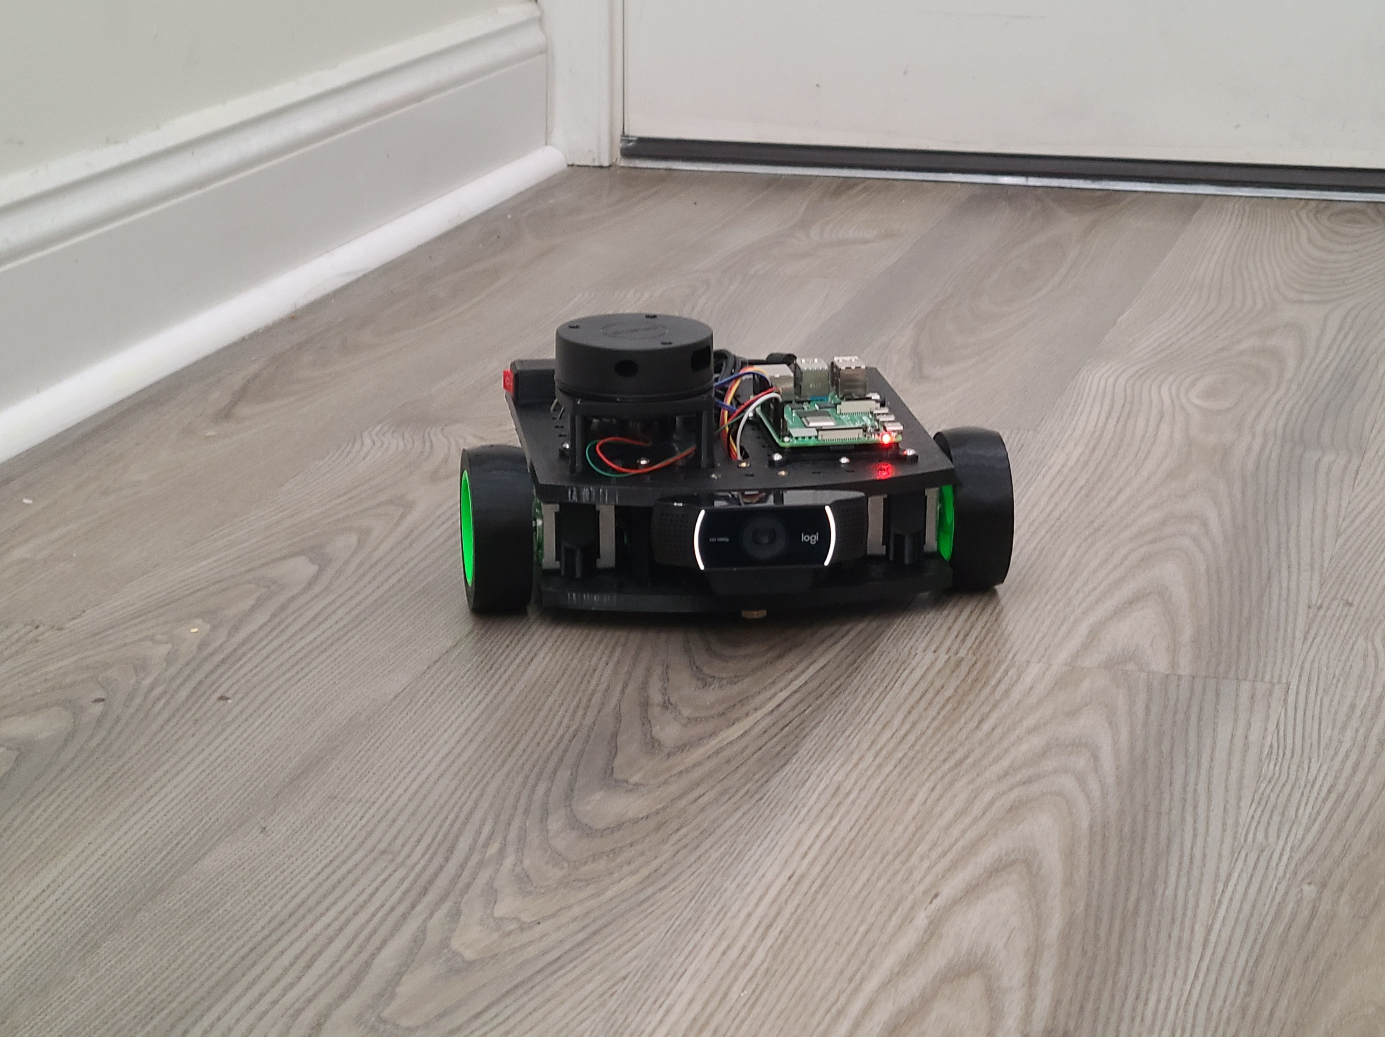
Voice-demanded robot with autonomous navigation
Japheth Beiler
Tyler Lindsay
Gabriel Marx
Instructor
Dr. Sayed Reza
Technical Advisor
Dr. Truong Tran
Notes:
Gabriel
Introduce the project and group members, mention advisors

Slide 2
Purpose
This project is a demonstration of using machine learning and onboard sensors to navigate to objects safely while avoiding obstacles. With further development, we could specialize the application of the robot (e.g. rescue robot for situations dangerous for humans).
Notes:
Gabriel

Slide 3
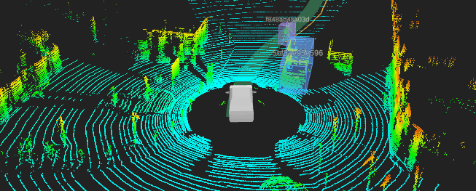
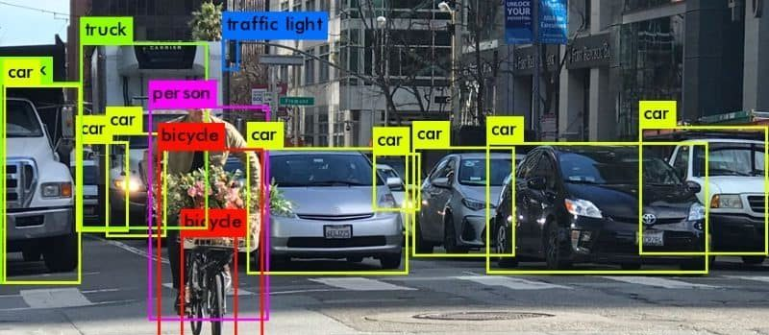
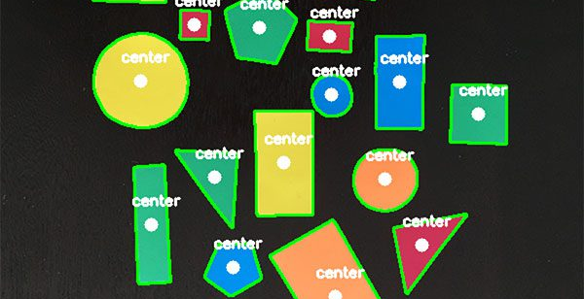
features
Interprets user speech as voice commands for movement
Uses computer vision to determine the position of targets (contour detection, centroid)
Processes LiDAR sensor data to determine distance and stop before collision
Uses LiDAR data to sense objects and move around them while searching for target
Azure machine learning object recognition
Provides web interface for displaying computer vision output and for manually controlling the robot
Notes:
Gabriel

Slide 4
Design considerations
Webcam: video & microphone quality, drivers for Linux
Raspberry Pi: processing power, networking
Battery pack: output requirements
Motors: movement accuracy
Cloud server: processing power, networking delay
Python libraries
Multithreading and concurrent programming
Internet protocol (IP): TCP & UDP
Computer vision: optimizations

Slide 5
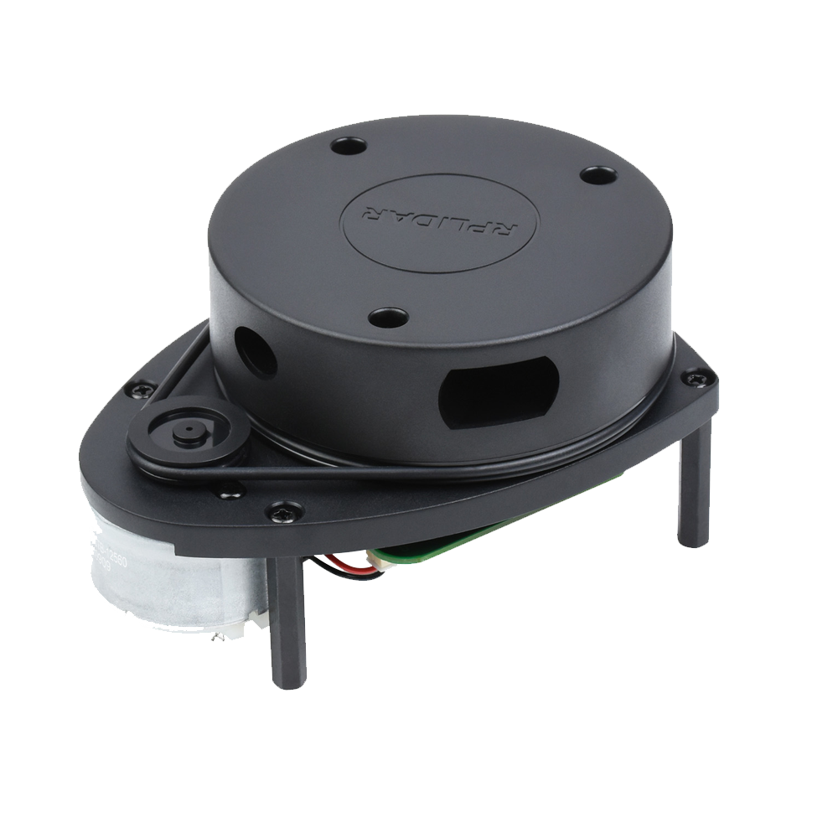
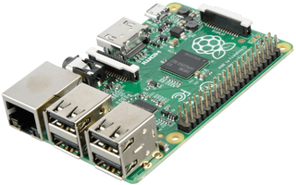
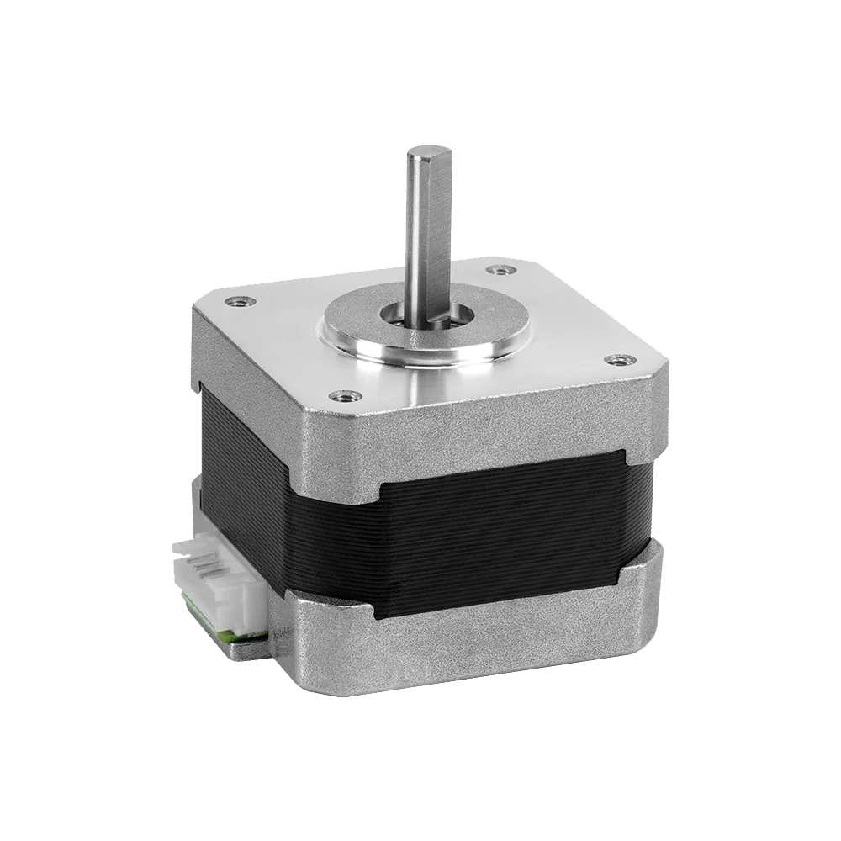
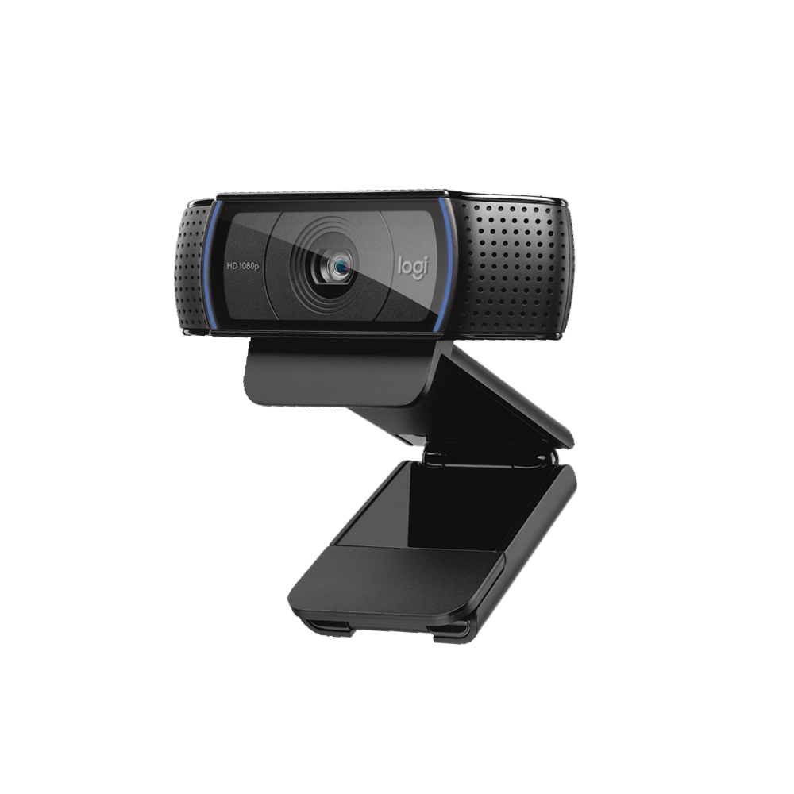
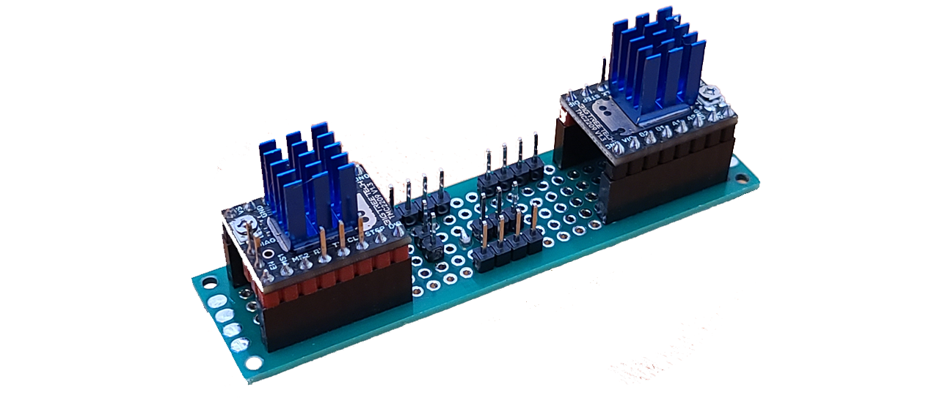
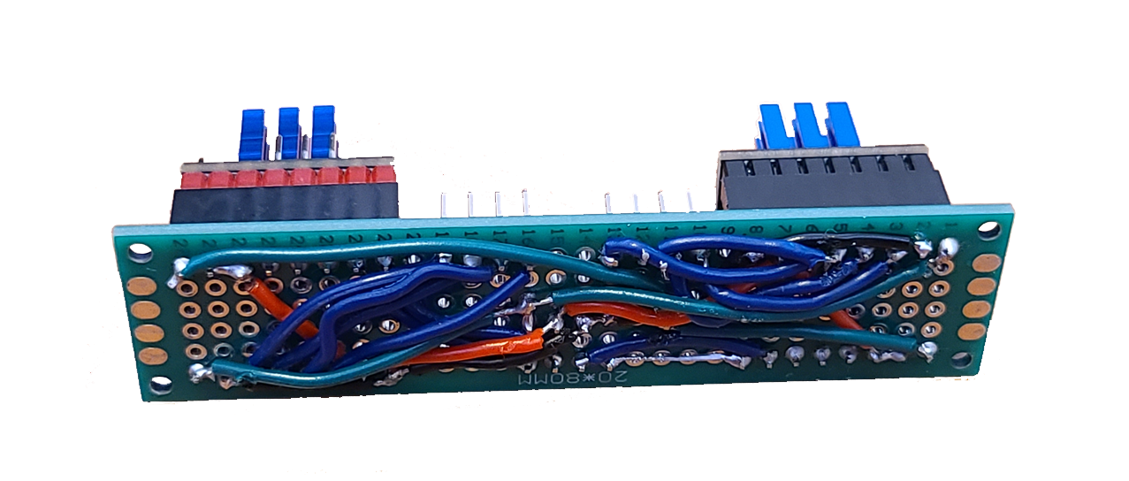
The Hardware
Raspberry Pi 4
LiDAR Scanner
Stepper Motors
Logitech Webcam
Hand-Soldered Circuit Boards
Fully 3D-Printed Construction
Notes:
Tyler
Talk about:
The wiring between components
How time and money was wasted on motors which did not work well enough
Lead into 3d models

Slide 6
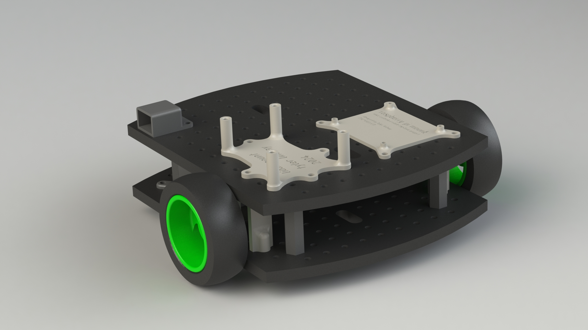
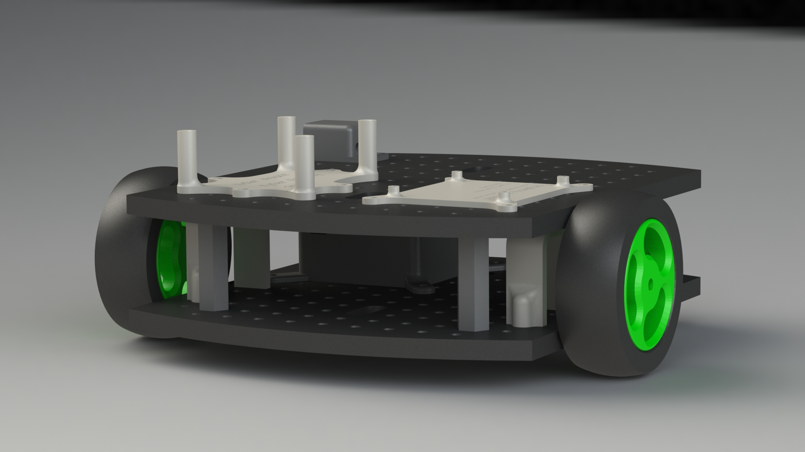
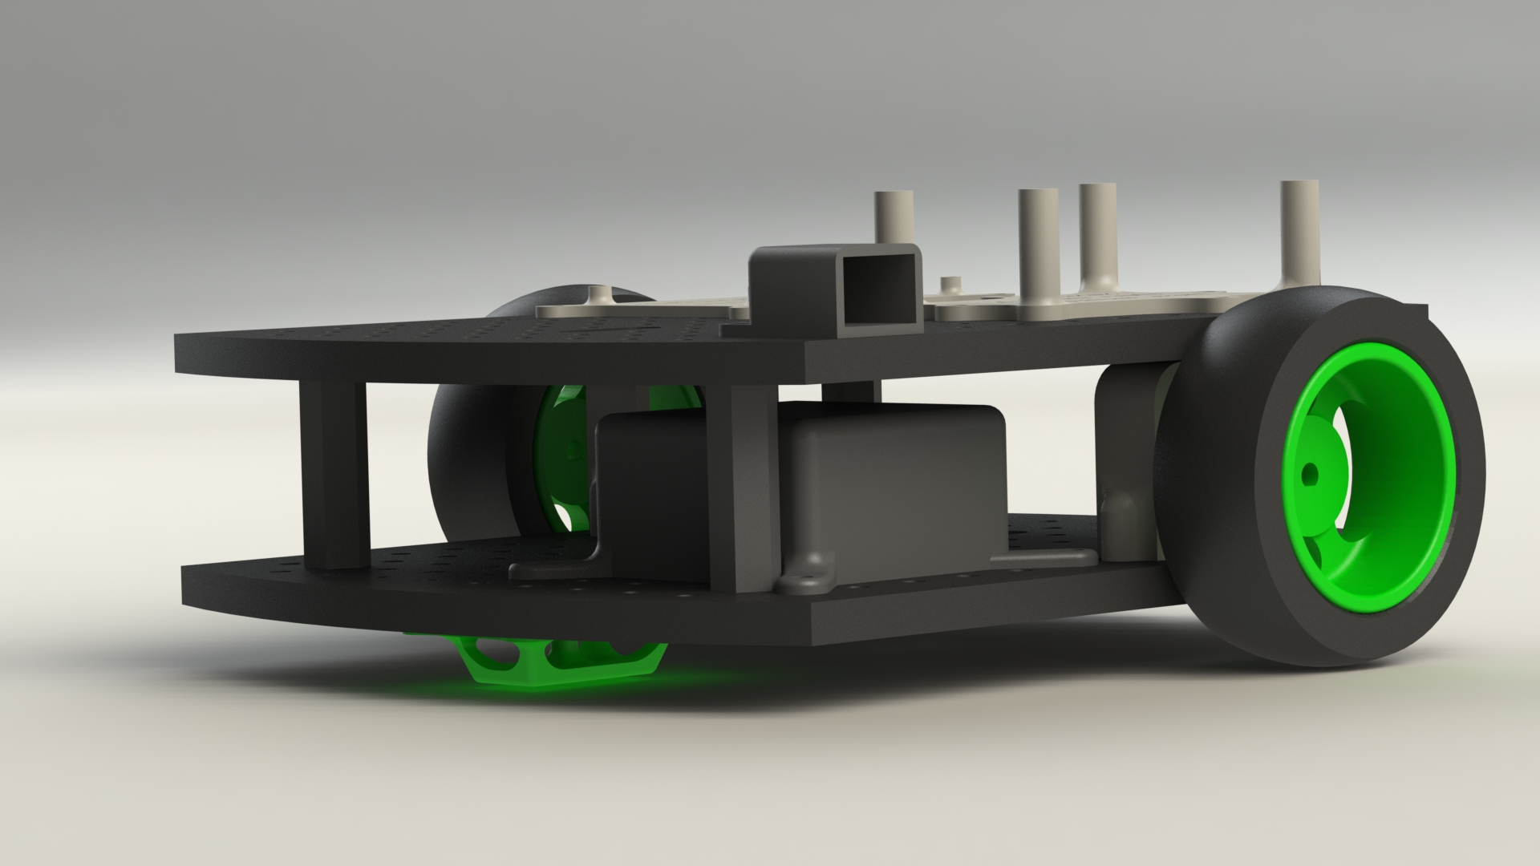
3d models
Notes:
Tyler

Slide 7









The software
TCP & UDP internet protocol
DigitalOcean: Server hosting
Flask: Web interface
Azure: Object recognition
OpenCV: Computer vision
OpenAI Whisper: Voice transcription
Real-time programming
Multithreading
Notes:
JJ

Slide 8
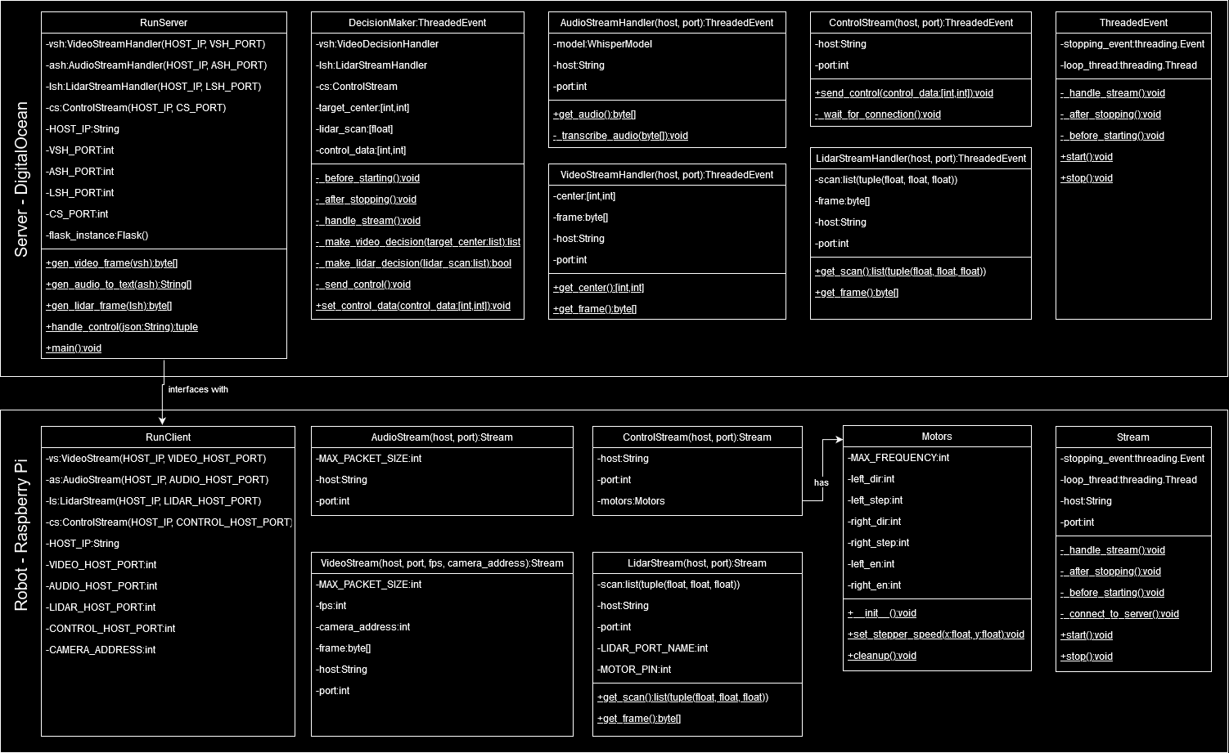
Implementation
Notes:
JJ
There’s a lot on this slide. Briefly explain the interface between the robot and the cloud server: touch on TCP vs. UDP which was explained earlier. Touch on how we extended abstract classes to reduce the amount of code needed, and how it made our codebase easier to collaborate on. Ex: ThreadedEvent abstracting away the multithreading, meant we didn’t need to worry about that.

Slide 9
Challenges
Video delay
Control accuracy
Collaboration
Notes:
Gabriel, Tyler, JJ
- We didn’t really overcome the issue of video delay, we worked with it by reducing movement speed for functionality which required processing the video data, and implementing functionality such that it does not depend on low delay in the video data. Ex: Using lidar (which has a much lower delay) to stop the robot & not moving forward/backward when turning to face target.
- Using stepper motors for movement made control more accurate – contrast with original motors.
- Collaborating was difficult since our project is partially hardware-based. We overcame by using abstract classes, developing a testing environment where we can emulate the robot data in the client and run both the client and server locally.

Slide 10
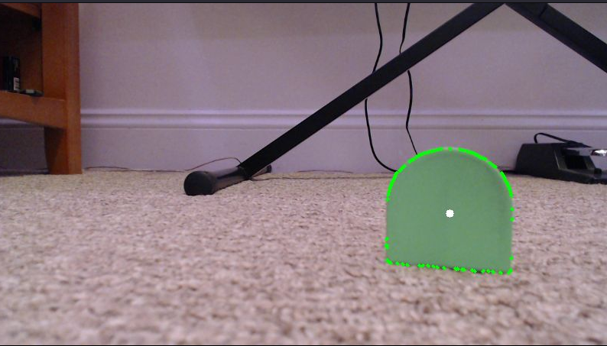
Unit testing
Processed image with contour and
Centroid visible
Image before processing
with Python’s unittest library
Notes:
JJ
Explain how developing unit tests for this project was difficult and required the use of code to generate test data and use captured images as input.

